Slide 1
Open discussions
How to learn a program language like C++?
How many hours needed per week?
What practices should be performed off-class?
How to get a high score in the final?
How to be a good developer with C++?
Is C++ useful for doing science research?
Slide 1- <number>

Slide 2
Chapter 1~2
Introduction to C++
C++ As A “Better” C
A/Prof. Liang Lin
School of Software, Sun Yat-Sen University
Course page: http://ss.sysu.edu.cn/~ll/course_c++.html

Slide 3
Overview
Introduction C++
C++ Standard Library
Header Files
Inline Functions
References and Reference Parameters
Default Arguments and Empty Parameter Lists
Unary Scope Resolution Operator
Function Overloading
Function Templates
Slide 1- <number>

Slide 4
Introduction to C++
C++ is derived from the C language
C++ developed by Bjarne Stroustrup at AT&T
Bell Labs in the 1980s as an enhancement to the C language. Originally named C with Classes, the language was renamed C++ in 1983.
  Overcame several shortcomings of C
  Incorporated object oriented programming
  C remains a subset of C++
Slide 1- <number>

Slide 5
Introduction to C++
C++
  Improves on many of C's features
  Has object-oriented capabilities
    Increases software quality and reusability
    Called "C with classes"
    C++ (increment operator) - enhanced version of C
  Superset of C
    Can use a C++ compiler to compile C programs
    Gradually evolve the C programs to C++
ANSI C++
  Final version at http://www.ansi.org/
  Free, older version at http://www.cygnus.com/misc/wp/
Slide 1- <number>

Slide 6
Introduction to C++
C 语言缺点:本身没有支持代码重用的语言结构， 不适合开发大型程序，当规模达到一定程度时，程序员很难控制程序的复杂度。
区别：
 | C | C++
编程方法 | 面向过程 | 面向对象
程序格式 | main() + 若干子模块 | main() + 若干类定义
实质 | 数据 + 算法 | 对象 + 消息

Slide 7
C++ and Object Oriented Programming
Abbreviated OOP （半面向对象）
Used for many modern programs
Program is viewed as interacting objects
  Each object contains algorithms to describe
  its behavior
  Program design phase involves designing
  objects and their algorithms
Slide 1- <number>

Slide 8
OOP Characteristics
Encapsulation（封装）
  Information hiding
  Objects contain their own data and algorithms
Inheritance（继承）
  Writing reusable code
  Objects can inherit characteristics from other objects
Polymorphism（多态）
  A single name can have multiple meanings depending
  on its context
Slide 1- <number>

Slide 9
A Sample C++ Program
Preprocessor
directives
// Program: Hello world
// Author(s): XXX Programmer
// Date: 12/12/2012
#include <iostream>
#include <string>
using namespace std;
int main() {
cout << "Hello world!" << endl;
return 0;
}
Comments
Provides simple access
// using std::cout;
Function named main() indicates start of program
Ends executions
of main() which ends program
Insertion
statement
Function
Slide 1- <number>

Slide 10
Running a C++ Program
C++ source code is written with a text editor
The compiler on your system converts
source code to object code.
The linker combines all the object code
into an executable program.
一个程序的源码可由多个文件组成。这些文件在第二步中分别编译(Compile)，生成各自的目标文件，链接(Link)的作用便是将这些目标文件，以及程序中需要的其它库文件，统一到一个文件中来，形成单个的可执行文件。
Execute＝Compile＋Build＋执行；
Slide 1- <number>

Slide 11
Run a Program
Obtain code in Display 1.1
Compile the code
Fix any errors the compiler indicates and
re-compile the code
Run the program
Now you know how to run a program on
your system
Display 1.1
Slide 1- <number>

Slide 12
Improvements of C++
File extensions
  C files: .c
  C++ files: .cpp (which we use), .cxx, .C (uppercase)
Differences
  C++ allows you to "comment out" a line by preceding it with //
  For example: // text to ignore
  <iostream> - input/output stream header file
  Return types - all functions must declare their return type
    C does not require it, but C++ does
  Variables in C++ can be defined almost anywhere
    In C, required to defined variables in a block, before any executable statements
Slide 1- <number>

Slide 13
Improvements of C++
Input/Output in C++
  Performed with streams of characters
  Streams sent to input/output objects
Output
  std::cout - standard output stream (connected to screen)
  << stream insertion operator ("put to")
  std::cout << "hi";
    Puts "hi" to std::cout, which prints it on the screen
Input
  std::cin - standard input object (connected to keyboard)
  >> stream extraction operator ("get from")
  std::cin >> myVariable;
    Gets stream from keyboard and puts it into myVariable
Slide 1- <number>

Slide 14
Improvements of C++
std::endl
  "end line"
  Stream manipulator - prints a newline and flushes output buffer
    Some systems do not display output until "there is enough text to be worthwhile"
    std::endl forces text to be displayed
using statements
  Allow us to remove the std:: prefix
  Discussed later
Cascading
  Can have multiple << or >> operators in a single statement
  std::cout << "Hello " << "there" << std::endl;
Slide 1- <number>

Slide 15
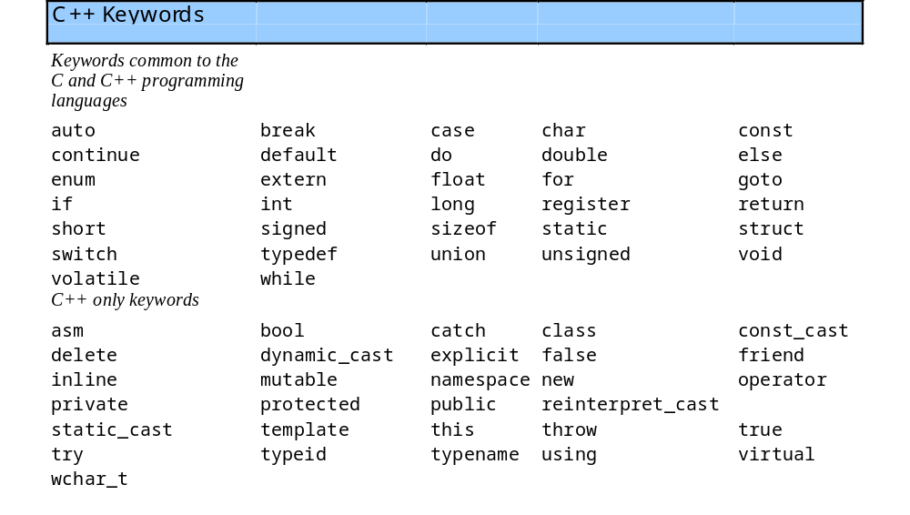
Improvements of C++
  Bool and Keywords
  Boolean - new data type, can either be true or false
Slide 1- <number>

Slide 16
C++ Standard Library
C++ programs built from
  Functions
  Classes
    Most programmers use library functions
Two parts to learning C++
  Learn the language itself
  Learn the library functions
Making your own functions
  Advantage: you know exactly how they work
  Disadvantage: time consuming, difficult to maintain efficiency and design well
Slide 1- <number>

Slide 17
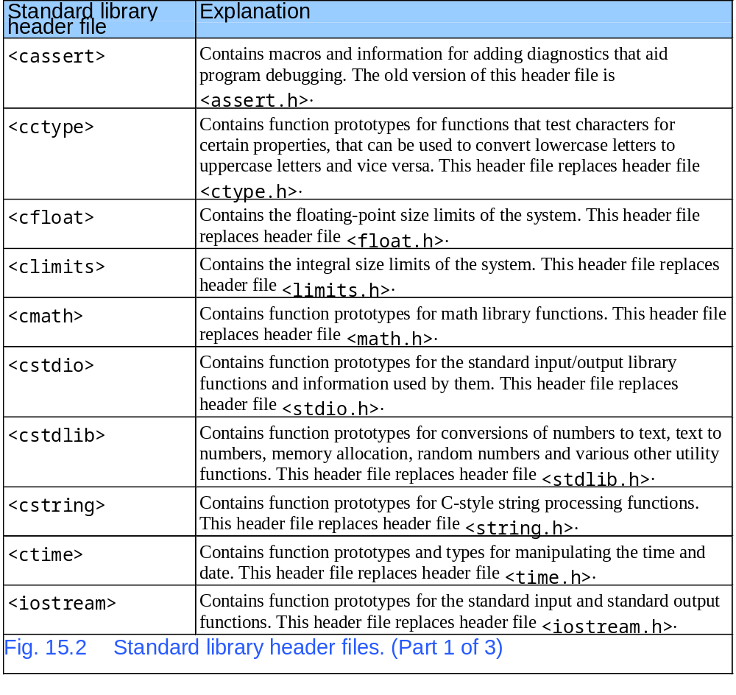
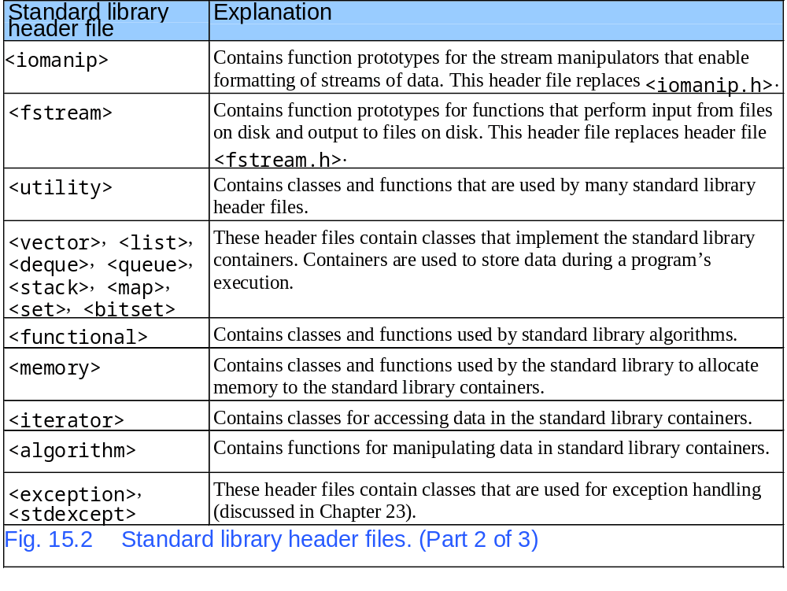
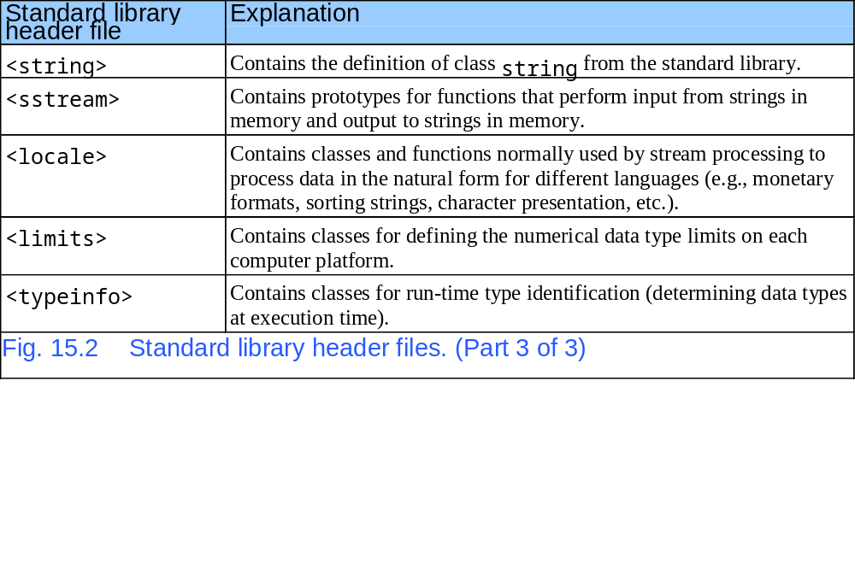
Header Files
Slide 1- <number>

Slide 18
Inline Functions
Function calls
  Cause execution-time overhead(开销)
  Keyword inline before function return type advises a function to be inlined.
    Puts copy of function's code in place of function call
  Speeds up performance but increases code size
  Compiler can ignore the inline keywords
    Ignores all but the smallest functions
  Example:
  inline int add( int a, int b )
  { return a + b; }
Slide 1- <number>

Slide 19
Inline Functions
函数调用的执行过程
main()
调fun()
结束
保存：
返回地址
当前现场
③
fun()
返回
①
②
④
⑦
恢复：
主调程序现场
返回地址
⑥
⑤
Slide 1- <number>

Slide 20
Inline Functions
每个函数名就代表了该函数的起始地址。
  当该函数被调用的时，主调函数保存现场，然后跳到被调用函数的地址开始执行。
  被调用的函数执行完毕之后，根据保存现场的信息，返回到主调函数的地址。
故在函数调用过程中发生了地址间的切换，降低函数执行的时间效率。
内联函数是指编译器使用函数代码替换函数调用，即其编译后的代码与其他程序代码“内联”起来了。实质上是以牺牲空间效率来提高时间效率。
注意：内联函数不能递归调用（编译器不允许），同时我们定义的内敛函数一般都要求简短，才能真正节省时间。
Slide 1- <number>

Slide 21
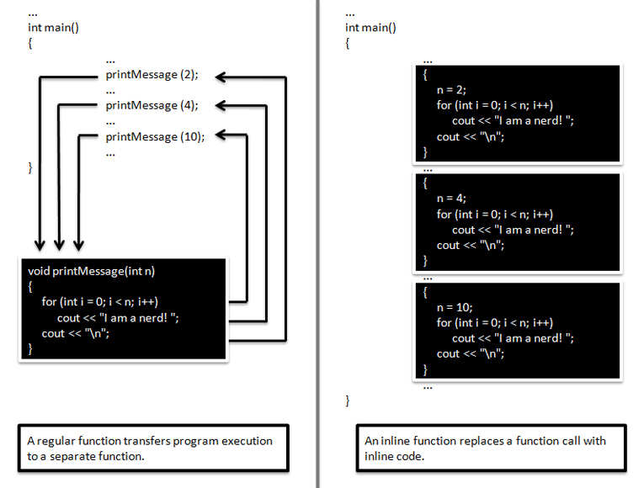
Inline Functions
Slide 1- <number>

Slide 22
References and Reference Parameters
Call by value
  Copy of data passed to function
  Changes to copy do not change original
Call by reference
  Function can directly access data
  Changes affect original
Reference parameter alias for argument.
  Adds 3 to the original variable input
    void change(int &X) {
    X += 3;
    }
  int &x = y; // Changing y changes x as well
  int &y; // error, ‘y’: references must be initialized.
Slide 1- <number>

Slide 23
References and Reference Parameters
Call by Value
传入 X
主程序
被调用程序
X
5
X
5
Call by Reference
传入 X
主程序
被调用程序
X
5
X
Slide 1- <number>

Slide 24
References and Reference Parameters
Multiple references
  Like pointers, each reference needs an &
  int &a, &b, &c;
Dangling references ( references to destroyed variables )
  If a function returns a reference to a variable, make sure the variable is static, otherwise, it is automatic and destroyed after function ends.
Can you figure out the differences of using pointers?
Slide 1- <number>

Slide 25
Sample
1.传引用(Call By Reference)
void Swap(int &a, int &b) {
int Temp = a;
a = b;
b = Temp;
}
传调用此函数后程序输出为 3, 5。达到了两数的交换效果
2.值引用(Call By Value)
void Swap(int a, int b) {
int Temp = a;
a = b;
b = Temp;
}
传调用此函数后程序输出为 5, 3。实际上此函数并没有达到了两数的交换的效果
int main() {
int Number1 = 5;
int Number2 = 3;
Swap(Number1, Number2);
cout << Number1 << ", "
<< Number2;
return 0;
}
Slide 1- <number>

Slide 26
Default Arguments and Empty Parameter Lists
If function parameter omitted, gets default value
  Can be constants, global variables, or function calls
  If not enough parameters specified, rightmost go to their defaults
Set defaults in function prototype
  int myFunction( int x = 1, int y = 2, int z = 3 );

Slide 27
Default Arguments and Empty Parameter Lists
C++调用函数时，参数是自右到左入栈的。因此，默认形参必须从右向左连续定义，并且在一个默认形参的右边不能有非默认的形参。
int func(int a, int b = 2, int c = 3, int d = 4); //正确
int fun(int a, int b = 2, int c = 3, int d); //错误，d未定义
int fun(int a = 1, int b, int c = 3, int d = 4); //错误，b未定义
在调用函数时，如果省去了某个实参，那从这个实参开始到最右边的实参都要省去，省去的参数和默认值对应。
int func(int a, int b = 2, int c = 3, int d = 4);
func(1, , ,4); //错误
func(1); //正确
在函数声明和函数定义时，默认形参不要重复定义，有函数声明时，应该优先在声明时定义，如果没有函数声明，则在函数定义时定义
在函数原型声明时给出默认值时，形参名可以省略
int func(int , int = 2, int = 3, int = 4);
Slide 1- <number>

Slide 28
Default Arguments and Empty Parameter Lists
Empty parameter lists
  In C, empty parameter list means function takes any argument
    In C++ it means function takes no arguments
  To declare that a function takes no parameters:
    Write void or nothing in parentheses
    Prototypes:
  void print1( void );
  void print2();

Slide 29
Sample
void PrintChar( char c = '=', int n = 80 ) {
for (int i = 0; i < n; ++i)
cout << c;
}
What happens in the following invocations（调用）?
  PrintChar('*', 20);
  PrintChar('-');
  PrintChar();
Slide 1- <number>

Slide 30
Unary Scope Resolution Operator
Unary scope resolution operator (::) （域操作符）
  Access global variables if a local variable has same name
  Instead of variable use ::variable
static_cast<newType> (variable)
  Creates a copy of variable of type newType
  Convert ints to floats, etc.
Stream manipulators
  Can change how output is formatted
  setprecision - set precision for floats (default 6 digits)
  setiosflags - formats output
  setwidth - set field width
  Discussed in depth in Chapter 21

Slide 31
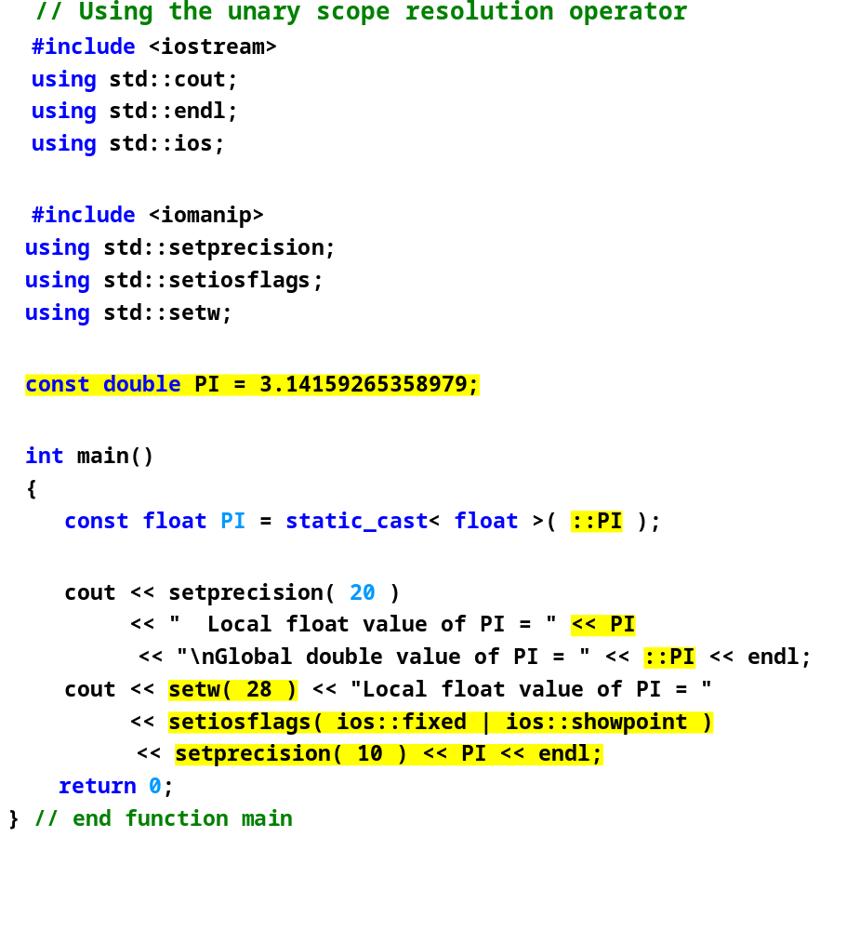
fig15_09.cpp
Borland C++ command-line compiler output
Local float value of PI = 3.141592741012573242
Global double value of PI = 3.141592653589790007
Local float value of PI = 3.1415927410
Microsoft Visual C++ compiler output
Local float value of PI = 3.1415927410125732
Global double value of PI = 3.14159265358979
Local float value of PI = 3.1415927410

Slide 32
Function Overloading
Function overloading(函数重载：功能相近的函数在相同的作用域内以相同函数名定义）
  Functions with same name and different parameters
  Overloaded functions should perform similar tasks
    Function to square ints and function to square floats
  int square( int x) {return x * x;}
  float square( float x ) { return x * x; }
  Program chooses function by signature（签名）
    Signature determined by function name and parameter types
    Type safe linkage - ensures proper overloaded function called
Note： 1）必须是同名函数
2）必须是不同的形参定义 个数上不同
类型上不同
3）不能只是返回类型上不一样

Slide 33
Function Overloading
重载函数的调用匹配依次按照下列规则判断
精确匹配：参数匹配而不做转换，或者只是做微不足道的转换，如数组名到指针、函数名到指向函数的指针、T到const T；
提升匹配：即整数提升（如bool 到 int、char到int、short 到int），float到double
使用标准转换匹配：如int 到double、double到int、double到long double、Derived*到Base*、T*到void*、int到unsigned int等等；
使用用户自定义匹配；
使用省略号匹配：类似printf中省略号参数
Slide 1- <number>

Slide 34
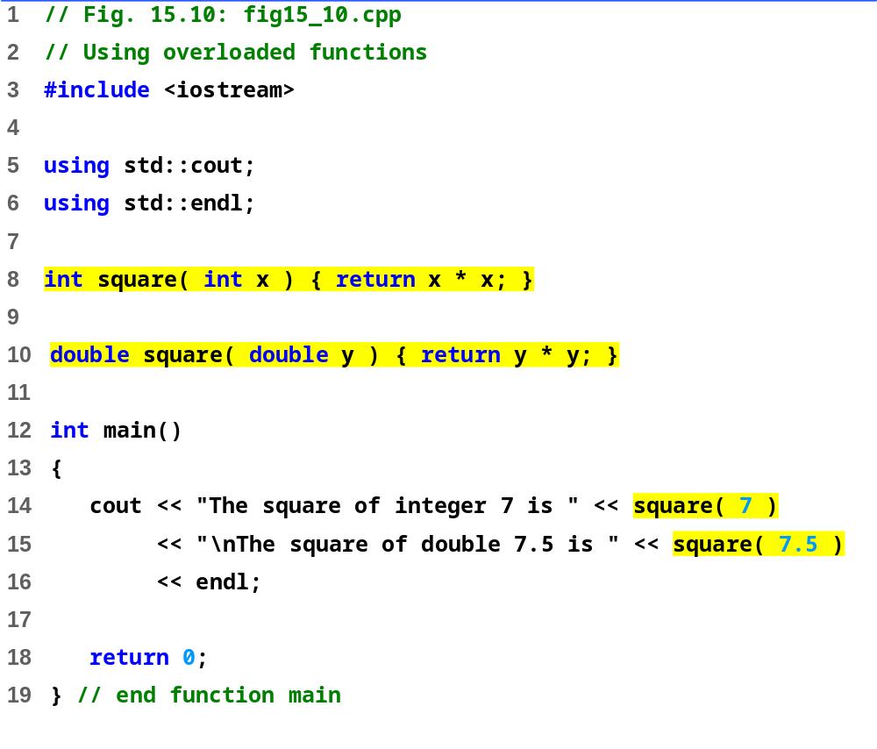
fig15_10.cpp
Output:
The square of integer 7 is 49
The square of double 7.5 is 56.25

Slide 35
Function Templates
Function templates （函数模板：把函数所使用的数据类型作为参数）
  Compact way to make overloaded functions
  Keyword template
  Keyword class or typename before every formal type parameter (built in or user defined)
  template < class T > //or template< typename T >
  T square( T value1)
  {
  return value1 * value1;
  }
  T replaced by type parameter in function call
      int x;
      int y = square(x);
      If int parameter, all T's become ints
      Can use float, double, long...

Slide 36
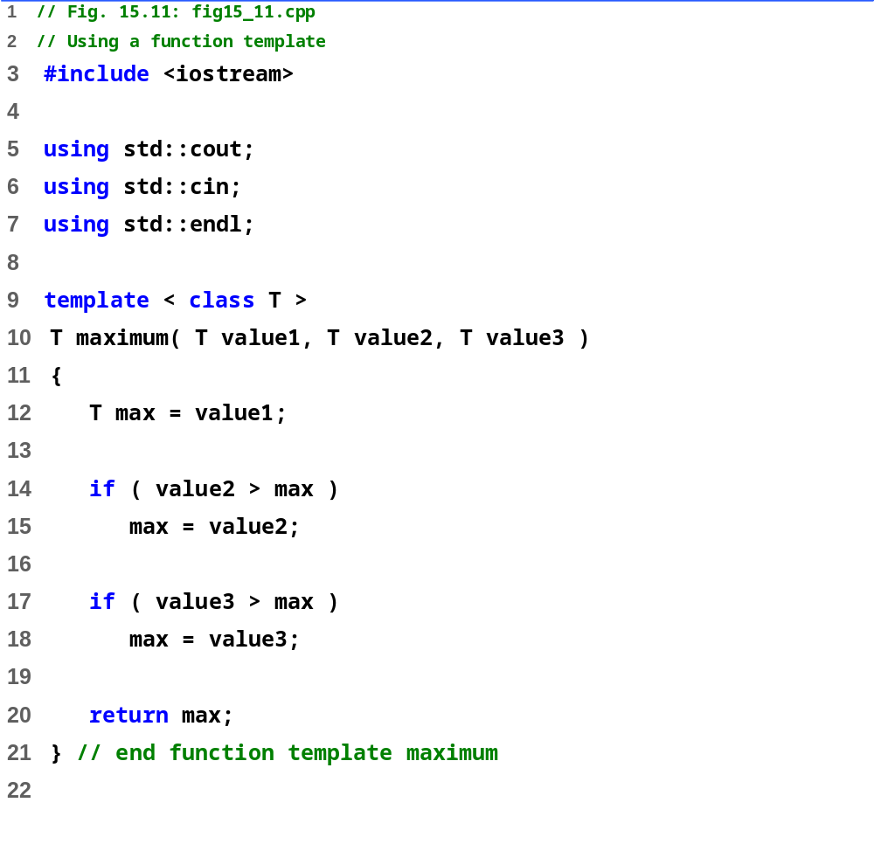
fig15_11.cpp (Part 1 of 2)

Slide 37
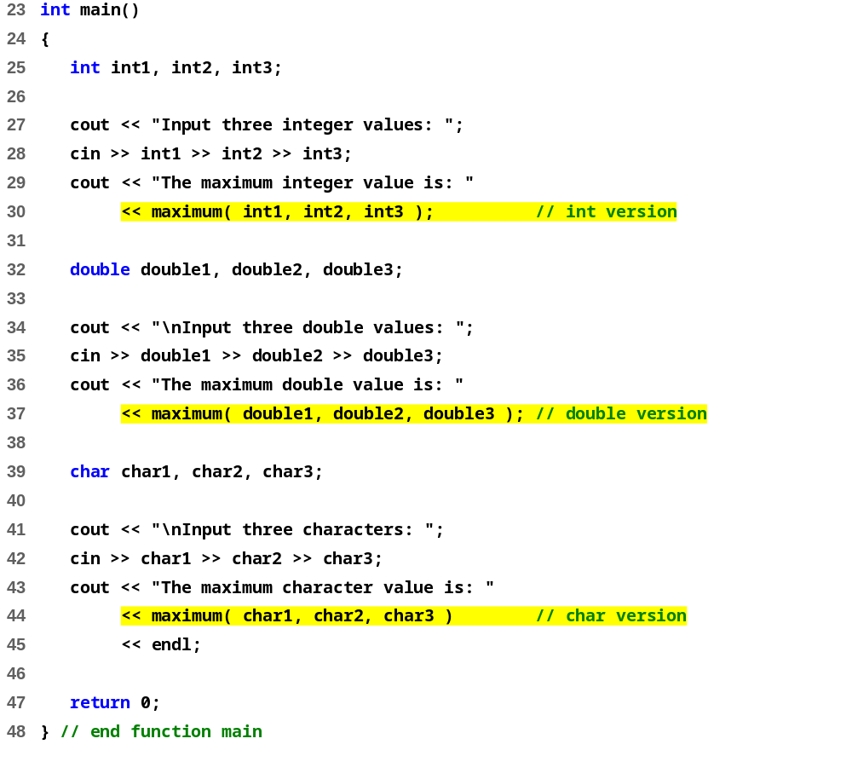
fig15_11.cpp (Part 2 of 2)
Input three integer values: 1 2 3
The maximum integer value is: 3
Input three double values: 3.3 2.2 1.1
The maximum double value is: 3.3
Input three characters: A C B
The maximum character value is: C

Slide 38
Chapter 1~2 -- End
Slide 1- <number>

Slide 39
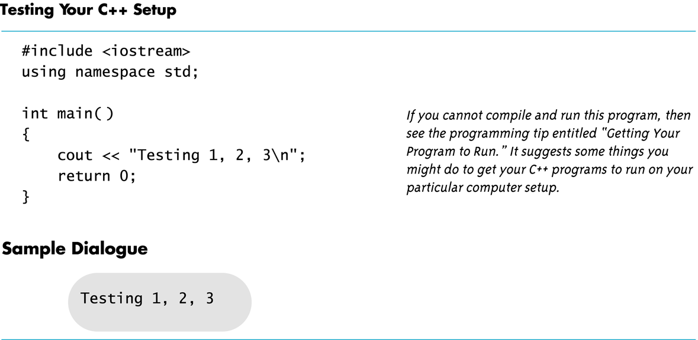
Display 1.1
Back
Slide 1- <number>

